Slide 1


Prologue to Internships
2021-22
Himanshu Pandey
Vedanth Venkatakrishnan

Slide 2
Why Internships ?
Experience: Help you figure out your career options
Looks good on the resume
Pre-Placement Offer (PPO)
Stipend!!

Slide 3
Types of Internships
Research
Programs (OIR, NYU)
Individual Approach (Professors’ Reference)
Industrial
SPO
Alumni (LinkedIn)
Social Work
NGOs
NITI Aayog, etc.
Startup
E-Cell (SIP)
Alumni (Linkedin)

Slide 4





Sectors Visiting IIT Kanpur
Analytics Core HFT and Quant
Software Finance

Slide 5



Approaching the upcoming Internships
Identify the Roles
Find out the required Skill Set and Eligibility Criteria
Start Preparation
Network with Seniors
Work on your Resume
Tests +
Interviews

Slide 6
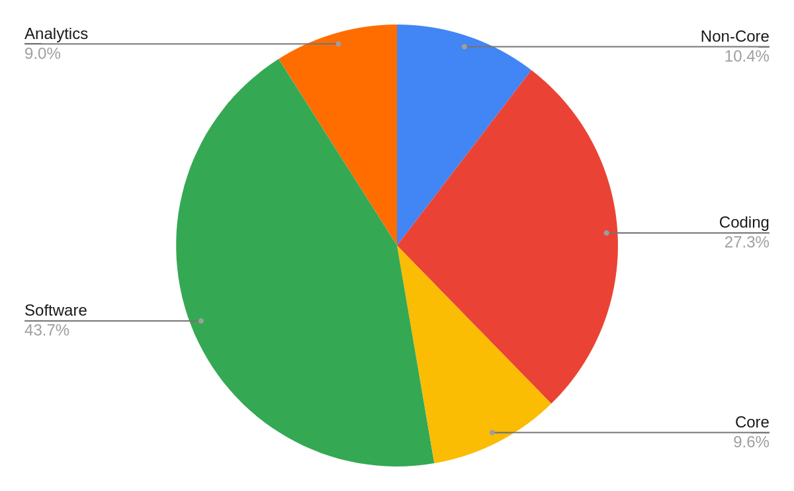
Internship Statistics

Slide 7
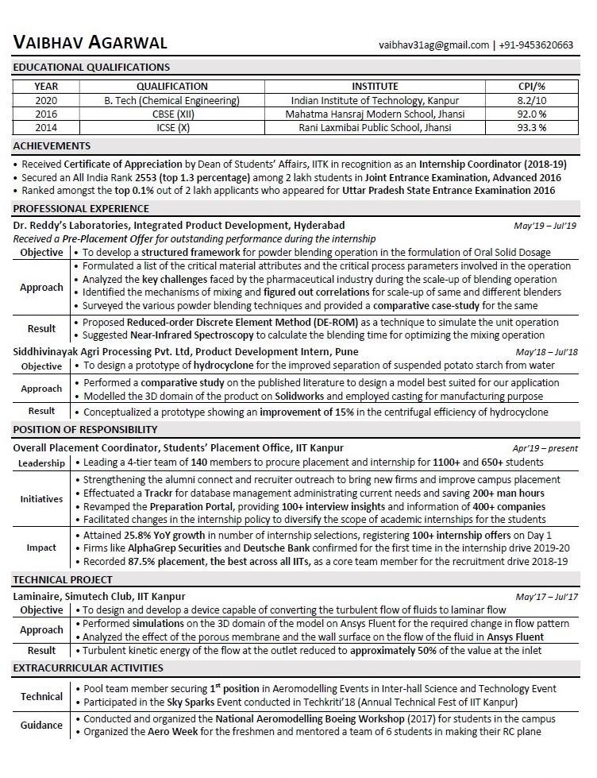
Resume
Create a Master Resume
Make sector-wise One Page Resumes
Get it reviewed by multiple seniors
In-depth knowledge of your resume
Play to your strengths (analyze your resume beforehand)
Make stories for relevant points

Slide 8
Software
Google Software
Microsoft
Samsung Korea
Rubrik
Nutanix
Uber
Adobe
Sprinklr
JP Morgan Chase & Co.
Samsung Research
Cohesity
D.E. Shaw
A.P.T Portfolio
AlphaGrep
SAP Labs
Wells Fargo
Amazon
Oracle
Flipkart
Walmart Labs

Slide 9
Process - Software
Online coding test
Questions on general coding problems, also some math problems
Interview Process
Intermediate programming questions
Algorithmic puzzles
Statistics and machine learning
Technical projects and past internship
Stress on complete, clean and error free code

Slide 10
Preparation Resources - Software
For theory: GeeksforGeeks
For practicing algorithms: interviewbit.com
You can google company specific questions asked in the interview
Revise the course on data structures and algorithms
You may be asked to write a code/algorithm on paper

Slide 11
Tips - Software
Practice coding in C++/ python
Practice coding on paper
Before going for the interview, see the solutions of those questions which you were not able to solve in the previous round

Slide 12
Analytics
American Express
Capital One
EXL Services
Axis Bank
AbInBev
Accenture
Gartner
Mastercard
Citi Bank
Fidelity Investments
OYO
Ola Cabs

Slide 13
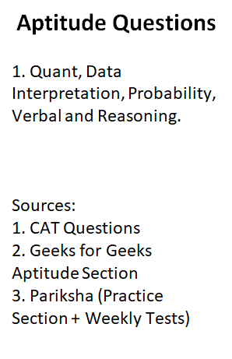
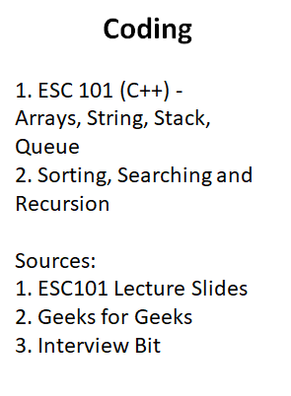
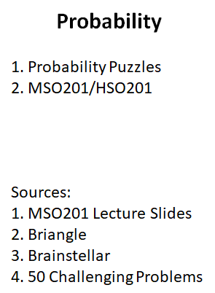
Test Preparation - Analytics

Slide 14
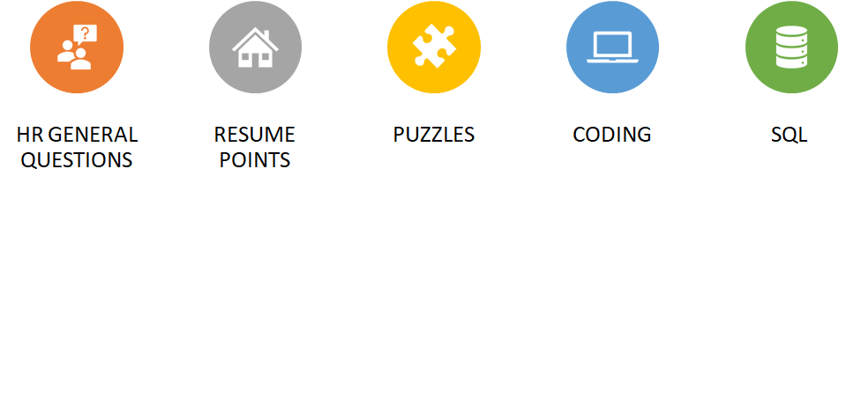
Interview Preparation - Analytics

Slide 15
HFT and Quant
Tower Research
AlphaGrep
Quadeye Securities
Graviton Trading
A.P.T. Portfolio
Nomura
JP Morgan Chase & Co.
Edelweiss

Slide 16
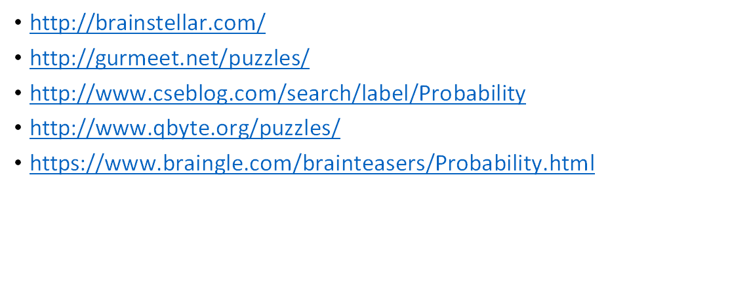
Preparation Resources - Quant

Slide 17
Books For Quant
A Practical Guide To Quantitative Finance Interviews by Xinfeng Zhou
Fifty Challenging Problems in Probability by Frederick Mosteller
Heard on the Street by Timothy Falcon Crack
Entertaining Mathematical Puzzles by Martin Gardner

Slide 18
Core
Google Hardware
Texas Instruments
Qualcomm
P&G
ITC
HUL
Vedanta
Schlumberger
Mitsubishi Heavy Industries
Sumitomo Precision Products
General Electric
Dr. Reddy's
Bajaj Auto
Reliance Industries
JSW

Slide 19
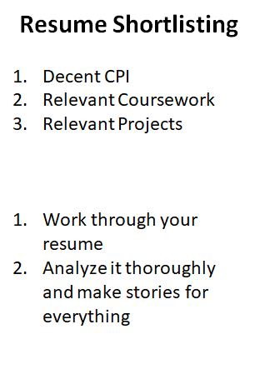
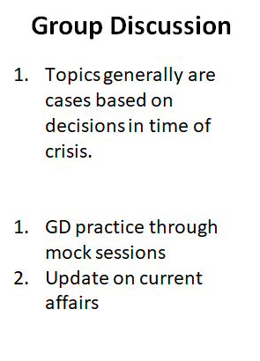
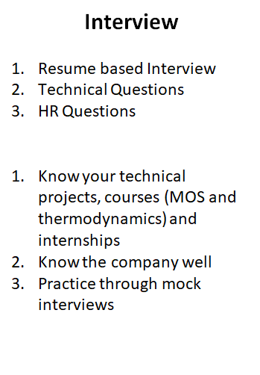
Process + Preparation - Core

Slide 20
Tips – Core
Be confident in the interview
Present your thoughts in a logical and structured manner
Use your projects/internships to justify your fit in the company
Get in touch with seniors who previously interned in the company

Slide 21
Finance
Nomura
Credit Suisse
Edelweiss
Futures First
Goldman Sachs
Barclays
HSBC GM

Slide 22
Process - Finance
Resume Shortlist and/or Aptitude Test
Basic Quant, Probability and Statistics, Finance
Interview Process
Resume based interview - past internship, projects and courses
Probability questions + current affairs (finance)
Finance theory and concepts
MSO201 theory

Slide 23
Preparation - Finance
Investopedia - Guide to Corporate Finance (https://www.investopedia.com/walkthrough/corporate-finance/)
SPO preparation resources (http://spo.iitk.ac.in/preparation/)
Finance Discussion Group sessions (https://tinyurl.com/FDGIITKLectures)
Bookmark Bloomberg Quint (bloombergquint.com)
Read The Economist whenever possible (weekly editions)
Subscribe to a financial daily (FE, BS, Mint)

Slide 24

HR Questions For more HR Questions: https://bit.ly/2FCe4uz

Slide 25
Timeline
2nd week of July
1st week of August
Resume Submission
Tests and PPTs start
Resume Verification
Interviews Begin
4th week of July
2nd week of August

Slide 26
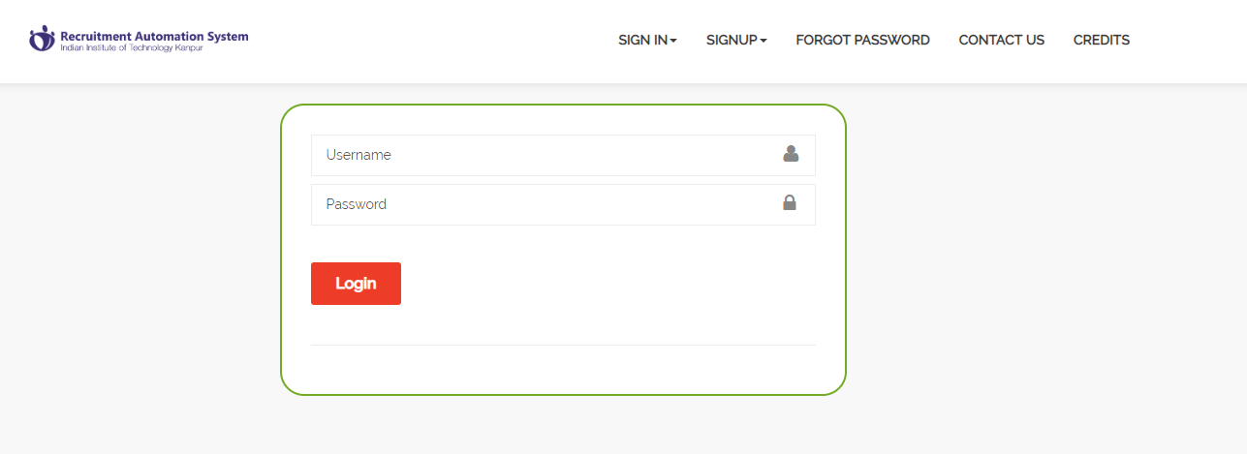
Internship Policies and Student Portal
Internship Policy: http://spo.iitk.ac.in/intern_policy.pdf
Student Portal: https://intern.iitk.ac.in/
Telegram Channel

Slide 27

Mentorship Program
2021-22
Academics and Career Council

Slide 28
What is Mentorship Program
It is an initiative to help you with your preparation for the internship season.
The mentor allotted to you will help you with all your basic queries to help you choose your field of interest and how to approach it and will share all the necessary resources.

Slide 29
Timeline
Introductory Profile wise preparatory sessions:
Core (Chemical, Mechanical and Electrical)
Software and Data Science
Techno managerial and Finance
Quant and HFT
Reshuffling of mentees and mentors:
Will happen post endsems
Will help you to get in touch with more seniors and get a new perspective to your preparation.
Can request for a mentor from a different profile if you feel the need for it.

Slide 30
Expectations
Enthusiasm from all of you.
Keep in constant touch with your mentors.
Contact us if your mentor is inactive.

Slide 31
Questions?

